Slide 1
Preparing for my career
Pr. Lamiae AZZOUZI

Slide 2
cover letter
Subject: motivation letter for my registration at the university of …… .. training…? POSITION ...
Dear Sir or Madam/ Mr./Mrs. Dupont / HR manager,
Currently in …… .. (current training, or diploma obtained), I wish to orient myself towards the training and professions of …… (the name of the profession: ex IT) ……… by integrating your establishment very recognized in this field and which offers training… .. (the name of training).
Passionate ……. (the field you want to do, add if you have experience in the field) ……… I like these various disciplines to which I try to forge links and towards which I would like to orient myself professionally.
I have done …… .cite the projects you have done

Slide 3
Through my various experiences and meetings, I would like to make a concrete commitment, after my training, in the profession of ………… (the job you want to do in the future) ……. To become a professional.
I got to know your establishment thanks to its reputation with the professionals I worked with during my career research. Also on social media platforms I was able to discuss with teachers, former students ... who advised me to register with your establishment and especially this ............ (the name of the training: master or license ) ……., Well known for the quality of its training, particularly in the field of …… .. (the name of the targeted field)

Slide 4
Very motivated, I am determined to train myself quickly in this field, being also very curious to be able to show in competence.
I hope I have convinced you of my motivation. I remain available to answer any further questions.
Please believe, Sir, Madam, in the expression of my most respectful greetings.
Best regards,
Sincerely yours,
Signature

Slide 10
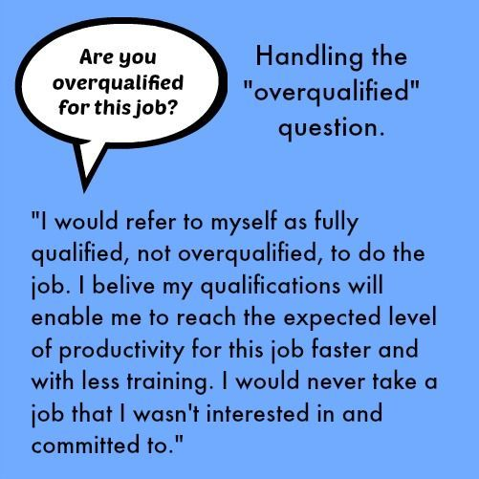

Slide 21
UP to you ?
Write a cover letter
Write a your own CV
Describe yourself
Describe your profile
What shoud we know about you ?
What should we hire you ?

Slide 22
Thank you

