Slide 1
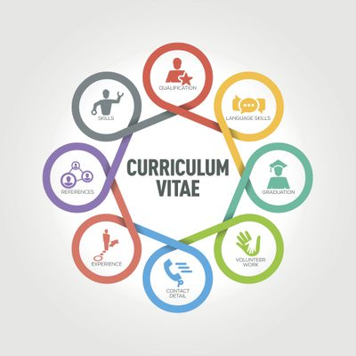
How to Write a Curriculum Vitae CV ?

Slide 2
a curriculum vitae should include your name, contact information, education, skills, and experience. In addition to these basics, however, a CV also includes research and experience, presentations, awards and honors, and other information relevant to the position you are applying for.

Slide 3
Start by making a list of all your background information, then organize it into categories. Make sure you include dates on all the publications you list.

Slide 4
Personal Information to Include in an International CV
Nationality
Marital status
Age
Number of children (ages optional)
Personal interests like hobbies
All education including high school / secondary school
Photos are also recommended (professional headshot is best)

Slide 5
Customize Your Curriculum Vitae
Once you have made a list of the information you want to include, it's a good idea to create a custom curriculum vitae that specifically highlights the experience you have that is relevant to the job you are applying for. It takes more time to write a custom CV, but it's worth the effort – especially when you are applying for jobs that are a good match for your skills and experience.

Slide 6
Use accomplishment-oriented bullets that start with an action verb and include a result.

Slide 8
Start with a Professional Profile (also called a Summary) that highlights the best of what you as a candidate is offering.

Slide 9
Edit content to include those areas of expertise, skills, and knowledge that specifically match the job requirements; not all the details of your education and employment history (work, research, fellowships, etc.) may be relevant.

Slide 10
Carefully rank and organize the sections of your resume according to what the institution you are applying for is seeking. For example, if you are applying to a university where research is emphasized, you should begin your list of publications on page one, right after your initial professional profile. If, on the other hand, you know that teaching is valued over publication by the department, you’ll want to give your professional career history pride of place on the first page.

Slide 11
Personal details and contact information. Most CVs start with contact information and personal data but take care to avoid superfluous details, such as religious affiliation, children's names and so on.
Education and qualifications. Take care to include the names of institutions and dates attended in reverse order; Ph.D., Masters, Undergraduate.

Slide 12
Work experience/employment history. The most widely accepted style of employment record is the chronological curriculum vitae. Your career history is presented in reverse date order starting with most recent. Achievements and responsibilities are listed for each role. More emphasis/information should be put on more recent jobs.

Slide 13
Skills. Include computer skills, foreign language skills, and any other recent training that is relevant to the role applied for.
Brief biography
Scholarships
Training
Project/s realized

Slide 14
Skills
Computer: Microsoft Office Suite, HTML, Proficient in Social Media, Adobe products, Data Entry, Typing: 50 WMP
Languages: Arabic : mother tongue English (fluent), Spanish (conversant), French (advanced)
Communication skills excellent communicator
Leadership skills

Slide 15
What Not to Include
There is no need to include your photo, your salary history, the reason you left your previous position, or references in your CV. References should be listed separately and given to employers upon request.

Slide 16
How Long Should a CV Be?
A good curriculum vitae should ideally cover no more than two pages and never more than three. Aim to ensure the content is clear, structured, concise and relevant. Using bullet points rather than full sentences can help minimize word usage.

Slide 17
Font and Size
Do not use ornate fonts that are difficult to read. Times New Roman, Arial, Calibri, or a similar font is best. Your font size should be between 10 and 12 points although your name and the section headings can be a little larger and/or bold

Slide 18
Page Margins
The standard page margins in word processing programs (1" margins on the top, bottom and left and right sides of the page) work for most resumes. However, if you need to tighten the margins to reduce the length of your resume, it's fine to reduce the margins to a 1/2" on the sides and top and bottom.

Slide 19
Layout
However, you decide to organize the sections of your resume, be sure to keep each section uniform. For example, if you put the name of one company in italics, every company name must be in italics. If you bold one job title, bold them all.

Slide 20
Information to Avoid
Do not include personal information such as birthday, height, weight, children, etc.,
unless the position requires it.

Slide 21
Accuracy
Be sure to edit your resume before sending it. Check spelling, grammar, tenses, names of companies and people, etc…

Slide 22
Thank you
any questions ?

