Slide 1
CAN YOU DESCRIBE YOUR PROFILE ?

Slide 2
Plan :
What is a professional profile and what is an interview ?
Why interviewrs ask you to describe your profile ?
What should you do to prepare to the question?
how to answer ?
How to answer the question as an engineer ?

Slide 3
What is a professional profile and what is an interview?
A professional profile is a brief summary of your skills, strengths, and key experiences. It also should convey what you are seeking or what you have to offer the person reading it.

Slide 4
What is a profile, and what is an interview ?

Slide 5
And An interview is a conversation between two or more people where questions are asked by the interviewer to elicit facts or statements from the interviewee, it’s a mutual exchange of information between an employer and you, as a candidate for a position. The primary objectives are to:

Slide 7
Show that you understand your strengths and weaknesses and have a sense of direction
Enable the employer to evaluate your personality and attitudes in terms of the demands of the organization and the position
Allow you to gain information about the organization and the job that is not available through other sources

Slide 8
Give you and the employer an opportunity to discuss the desirability of further contact or an offer of employment.
In an interview, while responding to questions, use to your advantage information that the employer volunteers about the position. Listen for verbal cues and hints (e.g., what is said, how it is said) and customize your responses accordingly, but be honest.

Slide 9
why interviewrs ask you to describe your profile ?

Slide 10
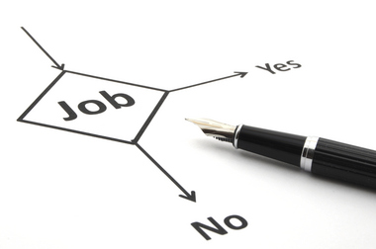

Slide 11
what should you do to prepare to the question? How to answer ?

Slide 13
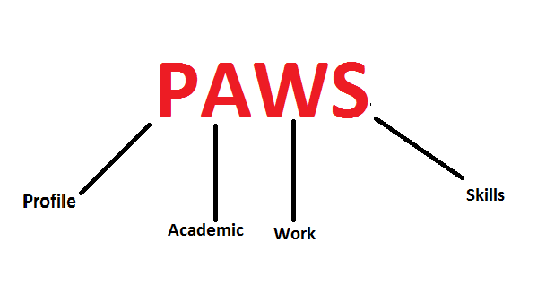
PAWS model

Slide 14
How to answer the question as an engineer ?

