Slide 1
The modern city

Slide 2
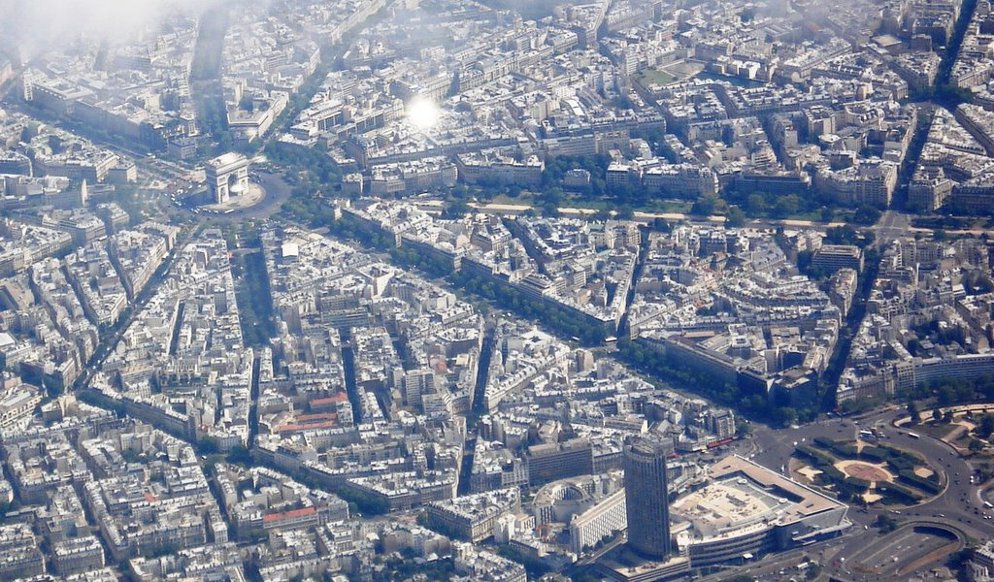

Slide 4
