Slide 1
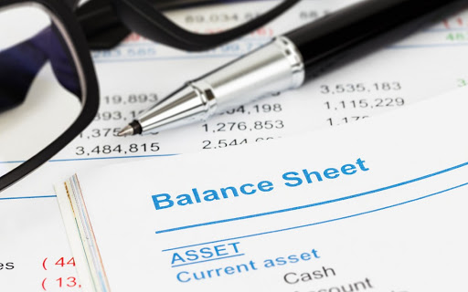
Balance Sheet

Slide 2
Plan
How a Balance Sheet Works?
What Is a Balance Sheet?
What's On the Balance Sheet?
Do I Need a Balance Sheet?

Slide 3
What Is a Balance Sheet?
A balance sheet is a financial statement that reports a company's assets, liabilities and shareholders' equity.
The balance sheet is one of the three (income statement and statement of cash flows being the other two) core financial statements used to evaluate a business.
The balance sheet is a snapshot, representing the state of a company's finances (what it owns and owes) as of the date of publication.
Fundamental analysts use balance sheets, in conjunction with other financial statements, to calculate financial ratios.

Slide 4
An Introduction To The Balance Sheet

Slide 5
What's On the Balance Sheet?

Slide 6
What's On the Balance Sheet?
The balance sheet is a snapshot representing the state of a company's finances at a moment in time. By itself, it cannot give a sense of the trends that are playing out over a longer period. For this reason, the balance sheet should be compared with those of previous periods. It should also be compared with those of other businesses in the same industry since different industries have unique approaches to financing.
A number of ratios can be derived from the balance sheet, helping investors get a sense of how healthy a company is. These include the debt-to -equity ratio and the acid-test ratio, along with many others. The income statement and statement of cash flows also provide valuable context for assessing a company's finances, as do any notes or. addenda in an earnings report that might refer back to the balance sheet .
Notes:
Acid-test ratio

Slide 7
How a Balance Sheet Works?
Assets
Equity
Liabilities

Slide 8
How a Balance Sheet Works?
1-Assets:
Assets are typically organized into liquid assets, or those that are cash or can be easily converted into cash, and non-liquid assets that cannot quickly be converted to cash, such as land, buildings, and equipment. They may also include intangible assets, such as franchise agreements, copyrights, and patents.

Slide 9
How a Balance Sheet Works?
2-Liabilities:
Liabilities are funds owed by the business and are broken down into current and long-term categories. Current liabilities are those due within one year and include items such as accounts payable (supplier invoices), wages, income tax deductions, pension plan contributions, medical plan payments, building and equipment rents, customer deposits (advance payments for goods or services to be delivered), utilities, temporary loans, lines of credit, interest, maturing debt, and sales tax and/or goods, and services tax charged on purchases.
Long-term liabilities are any that are due after a one-year period. These may include deferred tax liabilities, any long-term debt such as interest and principal on bonds, and any pension fund liabilities.

Slide 10
How a Balance Sheet Works?
3- Equity:
Equity, also known as owners' equity or shareholders' equity, is that which remains after subtracting the liabilities from the assets. Retained earnings are earnings retained by the corporation—that is, not paid to shareholders in the form of dividends.
Retained earnings are used to pay down debt or are otherwise reinvested in the business to take advantage of growth opportunities. While a business is in a growth phase, retained earnings are typically used to fund expansion rather than paid out as dividends to shareholders.

Slide 11
Do I Need a Balance Sheet?
Balance sheets are an important tool for assessing and monitoring the financial health of a business.
They typically include assets, liabilities, and owners' equity.
The U.S. government requires incorporated businesses to have balance sheets.

